Slide 1
Advancing Race Equity and Inclusion
Jann Jackson
Annie E. Casey Foundation
November 8, 2017

Slide 2
Why Prioritize Racial Equity?
“If we expect to help all children succeed, we must do more than closing gaps and pointing to disparities. All of our work must strive to achieve race equity, a state in which all children have the same opportunity to reach the potential we know they have.”
--Patrick McCarthy
President and CEO, The Annie E. Casey Foundation

Slide 3

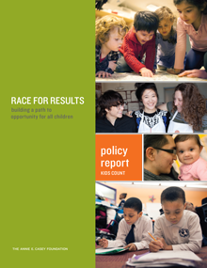
Race for Results

Slide 4
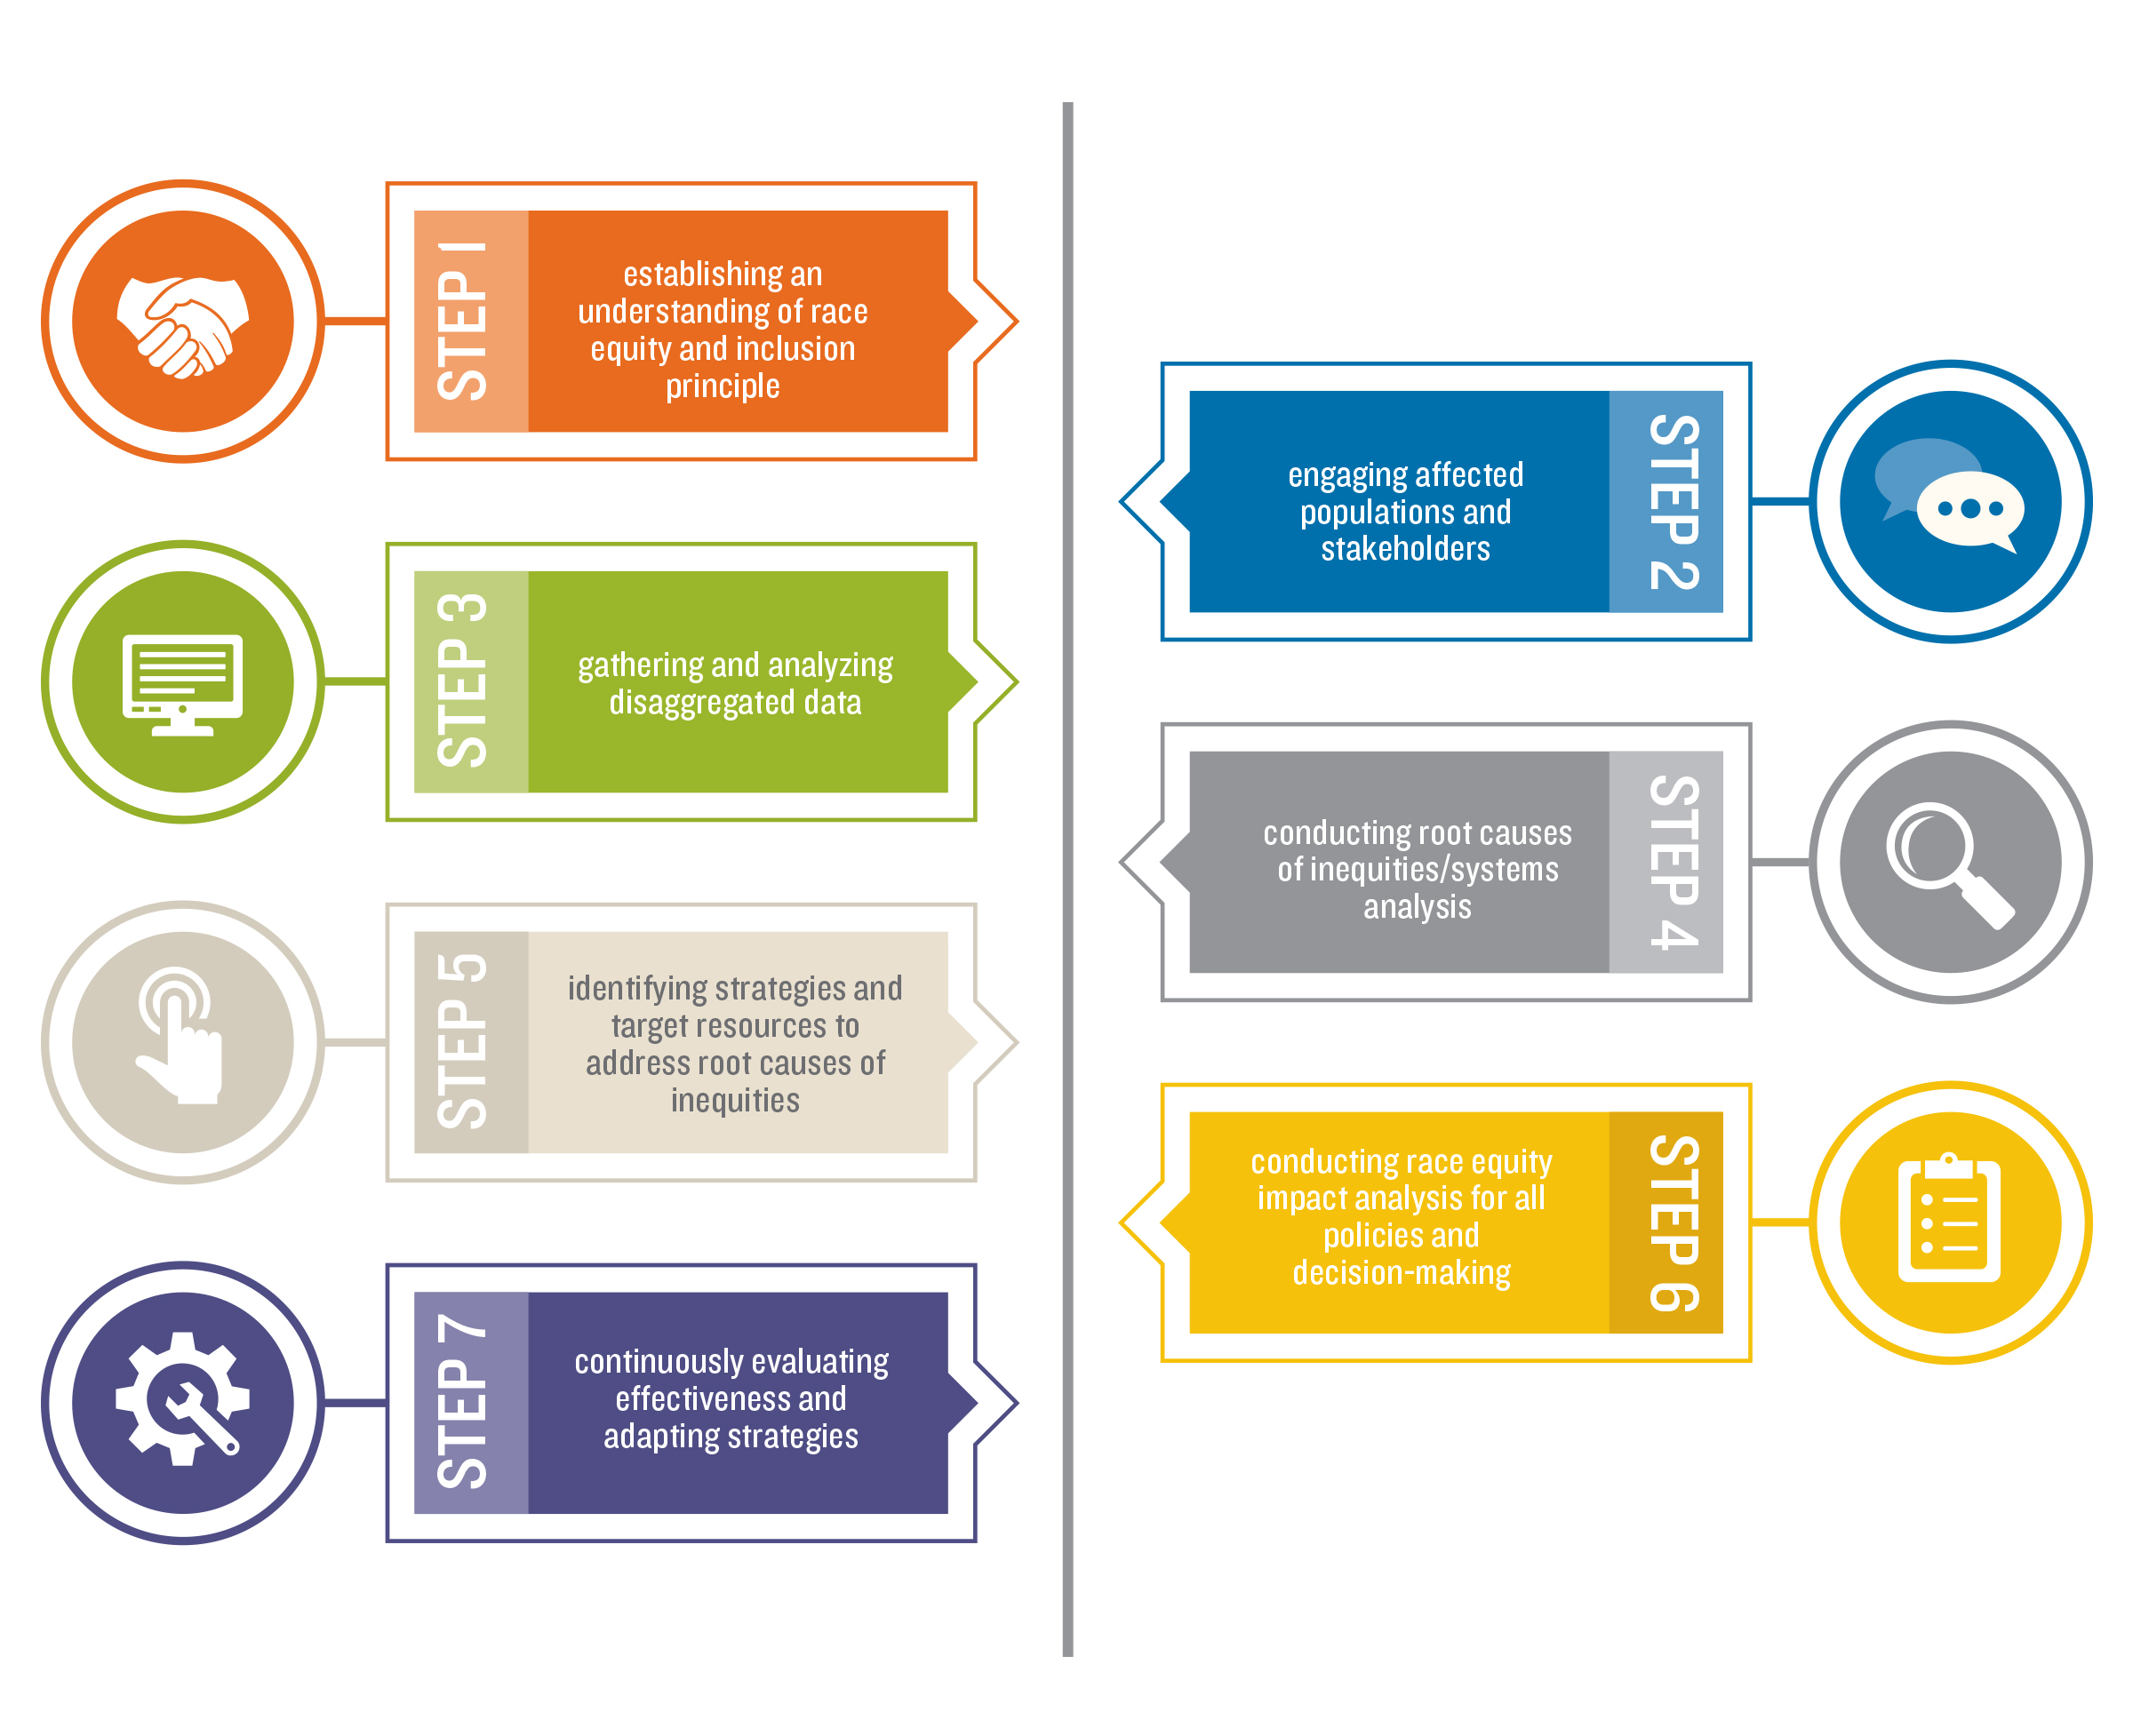
Seven Steps to Advancing
Racial Equity and Inclusion

Slide 5

Step 1: Establish an Understanding of Race Equity and Inclusion Principles
Evaluation
REIA
Strategies &
Resources
Systems Analysis
Engagement
Data
Language

Slide 6

Equality vs. Equity

Slide 7

Step 2: Engage Affected
Populations and Stakeholders
Evaluation
REIA
Strategies &
Resources
Systems Analysis
Data
Engagement
Language

Slide 8
Key Stakeholders
People of color are the most direct stakeholders in the elimination of racism and those with the most first-hand experiences with its effects.
Strive to engage stakeholders who have active and authentic connections to their respective communities.
The sooner you can engage a diverse mix of stakeholders, the better, so they can help establish the agenda, strategy and leadership.

Slide 9
From Engagement to Empowerment
Engagement may simply involve getting input or limited participation.
Empowerment involves taking leadership, making decisions and designing solutions and strategies at every phase of social change efforts. It ensures meaningful participation, voice and ownership.

Slide 10

Stakeholder Engagement Tips
Encourage civic participation
Avoid tokenism
Move from talk
to action

Slide 11
Using the Stakeholder Analysis Guide
Who is most adversely affected by racial barriers and bias, or exclusion from power, related to the issue being addressed?
How are people of different racial groups differently situated or affected by the issue?
What are ways stakeholders adversely affected by the issue can be further engaged?
How will stakeholders exercise real leadership and power?

Slide 12

Step 3: Gather and
Analyze Disaggregated Data
Evaluation
REIA
Strategies &
Resources
Systems Analysis
Data
Engagement
Language

Slide 13
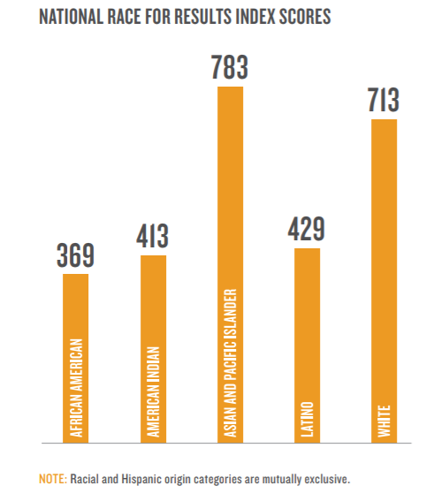
National Race for Results Index Scores

Slide 14

Step 4: Conduct Systems Analysis of Root Causes of Inequities
Evaluation
REIA
Strategies &
Resources
Systems Analysis
Data
Engagement
Language

Slide 15
About Systems
Systems are composed of an array of interdependent and interacting components.
Systems are self-perpetuating and constantly changing.
Systems can be transformed by finding high leverage points that can induce and reinforce ongoing change.
While actions and gains are followed by reactions and retrenchments, these can be anticipated and counteracted with thoughtful planning.

Slide 16
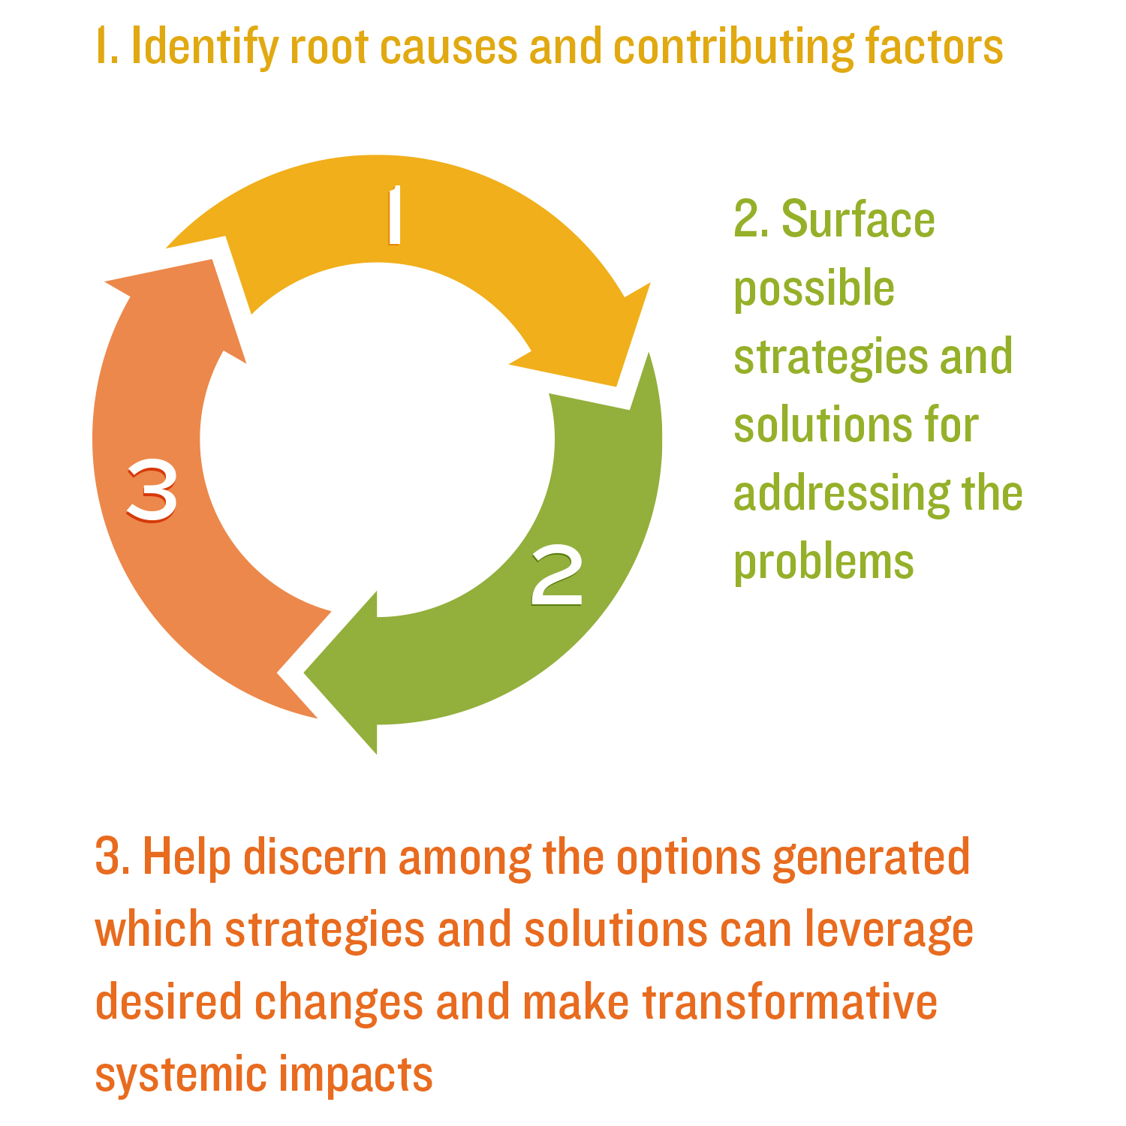
Why use a Systems Analysis?

Slide 17
Using the Systems Analysis Guide
What are the racial inequities involved?
What institutions are involved? What unfair policies are involved?
What other conditions or compounding dynamics are involved?
What norms, myths or popular ideas help maintain the problem?
How did things get this way and what are the cumulative impacts?
What are the causes and contributing factors?
What solutions or interventions could eliminate the inequities?

Slide 18

Step 5: Identify Strategies and Target Resources to Address Root Causes and Inequities
Evaluation
REIA
Strategies &
Resources
Systems Analysis
Data
Engagement
Language

Slide 19
Racially Equitable Solutions
Have explicit goal of eliminating racial disparities
Advance equity and expand opportunities
Include realistic mechanisms to attain, sustain and expand success

Slide 20
Using the Guide to Developing
Racially Equitable Solutions
What racial disparities do you want to eliminate, reduce or prevent?
What stakeholders most adversely affected by the current problem do you most want to benefit?
How does the proposed solution address root causes?
What positive values are reflected in the proposed solution?
Are there clear goals, plans and timetables for implementation?
Is there sufficient funding, staffing, reporting, accountability and evaluation to ensure success?

Slide 21

Step 6: Conduct Race Equity Impact Assessment for all Policies and Decision Making
Evaluation
REIA
Strategies &
Resources
Systems Analysis
Data
Engagement
Language

Slide 22
What are Racial Equity Impact Assessments?
A systematic examination of how a proposed action or decision will likely affect different racial and ethnic groups.
A vital tool to reduce, eliminate and prevent racial discrimination and inequities.
A tool that can be assess proposed policies, institutional practices, programs, plans and budgetary decisions.
A conscious mechanism for counteracting implicit bias.

Slide 23
Using the Race Equity Impact Analysis Guide for Policies & Decision-Making
Five Key Questions:
Are all racial/ethnic groups who are affected by the policy/practice/decision at the table?
How will the proposed policy/practice/decision affect each group?
How will the proposed policy/practice/decision be perceived by each group?
Does the policy/practice/decision worsen or ignore existing disparities?
Based on the above responses, what revisions are needed in the policy/practice/decision under discussion?

Slide 24

Step 7: Continuously Evaluate Effectiveness and Adapt Strategies
Evaluation
REIA
Strategies &
Resources
Systems Analysis
Data
Engagement
Language

Slide 25
Institutionalizing Equity and Inclusion
Organizations and systems should be assessing equity progress at every turn and on an ongoing basis.
Set goals for equity outcomes, measure progress and track results. Refine and revise strategies, as needed.
We can prevent institutional racism by institutionalizing racial equity.

Slide 26
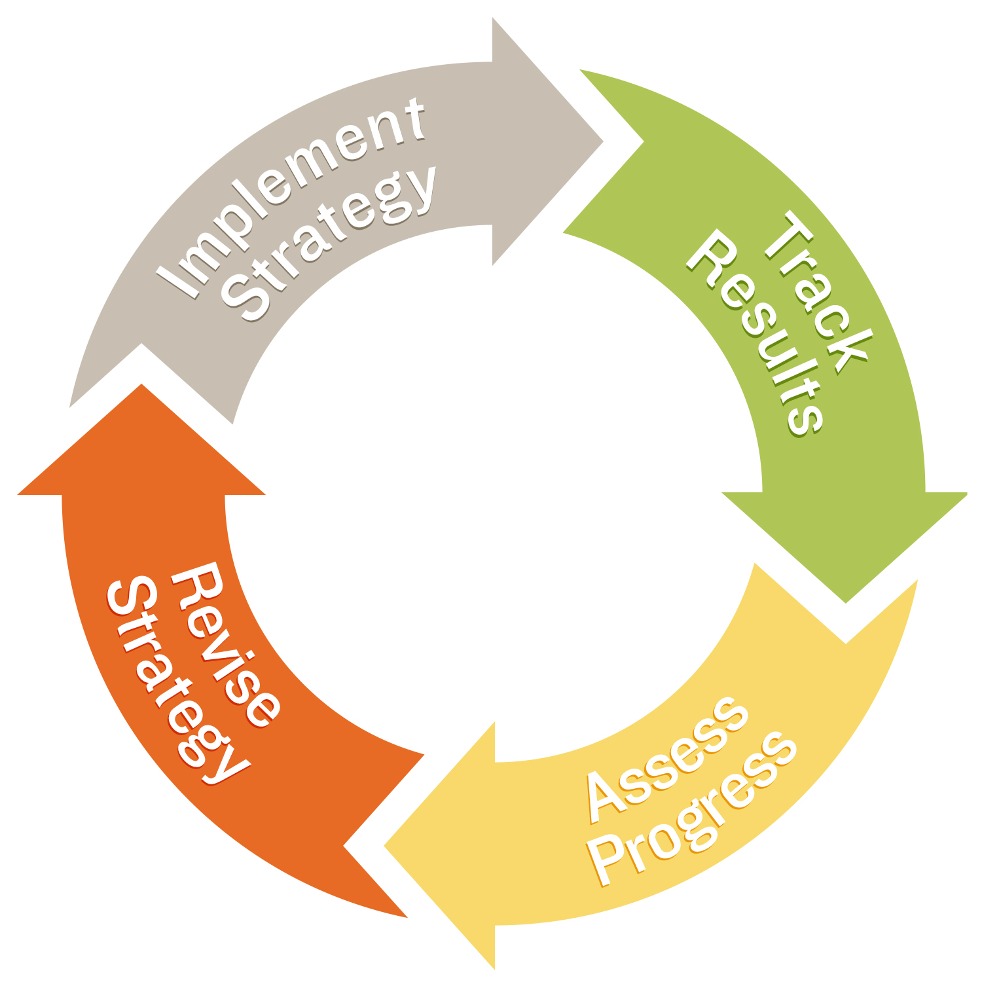
Sustaining and Supporting Success

Slide 27
In Summary
Follow the Seven Steps:
Develop a common understanding of key concepts.
Identify and engage the right stakeholders.
Examine disaggregated data.
Conduct systems analysis.
Design effective strategies.
Assess and measure impacts.
Evaluate and adapt your strategies over time.

Slide 28
In Summary
Use the four guides:
Stakeholder Analysis Guide
Systems Analysis Guide
Developing Racially Equitable Solutions Guide
Racial Equity Impact Assessment Guide

Slide 29
A New Operating System
Racial justice is not just the absence of discrimination and inequities, but also the presence of deliberate systems and supports to achieve and sustain racial equity.
Racial equity can be an aspirational and an operational framework for all facets of your work.
Racism is our society’s default operating system. We can all take leadership and be champions by using these steps and tools to create a new operating system based on racial equity and inclusion.

