Slide 1
State Levers for Increasing Access to Family Economic Security Benefits
Welcome to TEDx @ CONNECT23

Slide 3
Updating TANF & Re-coupling EITC
TANF:
Updates to eligibility and benefits amounts for first time in nearly three decades
How we got it done:
Legislative champions in a position to do something about it
Broad coalition of human services advocates and direct service organizations
Messaging around work
State abortion restrictions
Committed, long-term engagement and leadership
EITC:
Re-coupled state EITC to federal EITC
How we got it done:
Legislative champion heavily involved in state tax/fiscal policy
Engagement from religious community helped shore up anti-poverty, pro-family messaging
Able to talk about equity AND work, so appealing to wider base of support

Slide 5
“BIG SKY DENY”
-The New Republic
HOW A CHILD TAX CREDIT BILL
CHAMPIONED BY REPUBLICANS
WENT DOWN IN MONTANA
WWW.ZEROTOFIVE.ORG
2023 Alliance for Early Success
CONNECT

Slide 6
MONTANA POPULATION:
1.12 MILLION (2021)
5.1% UNDER AGE 5
MEDIAN HOUSEHOLD INCOME:
$60,560 (2021)
119,000 HOUSEHOLDS IN MONTANA CURRENTLY BENEFIT FROM THE FEDERAL CTC – MONTANA CURRENTLY HAS NO STATE CTC
FUN FACTS
Montana is 147,040 square miles (the largest land-locked state in the U.S.)
North Carolina is 48,607 square miles with a population of 10.55 million (2021)
Sources: U.S. Census Bureau, White House ARP analysis

Slide 7
2022 POLL: MAJORITY OF VOTERS SEE TAX CREDITS
AS A WAY TO LIFT COST BURDENS FOR MONTANA FAMILIES.
74%
Agree that tax credits help parents offset the cost of raising a child.

Slide 8
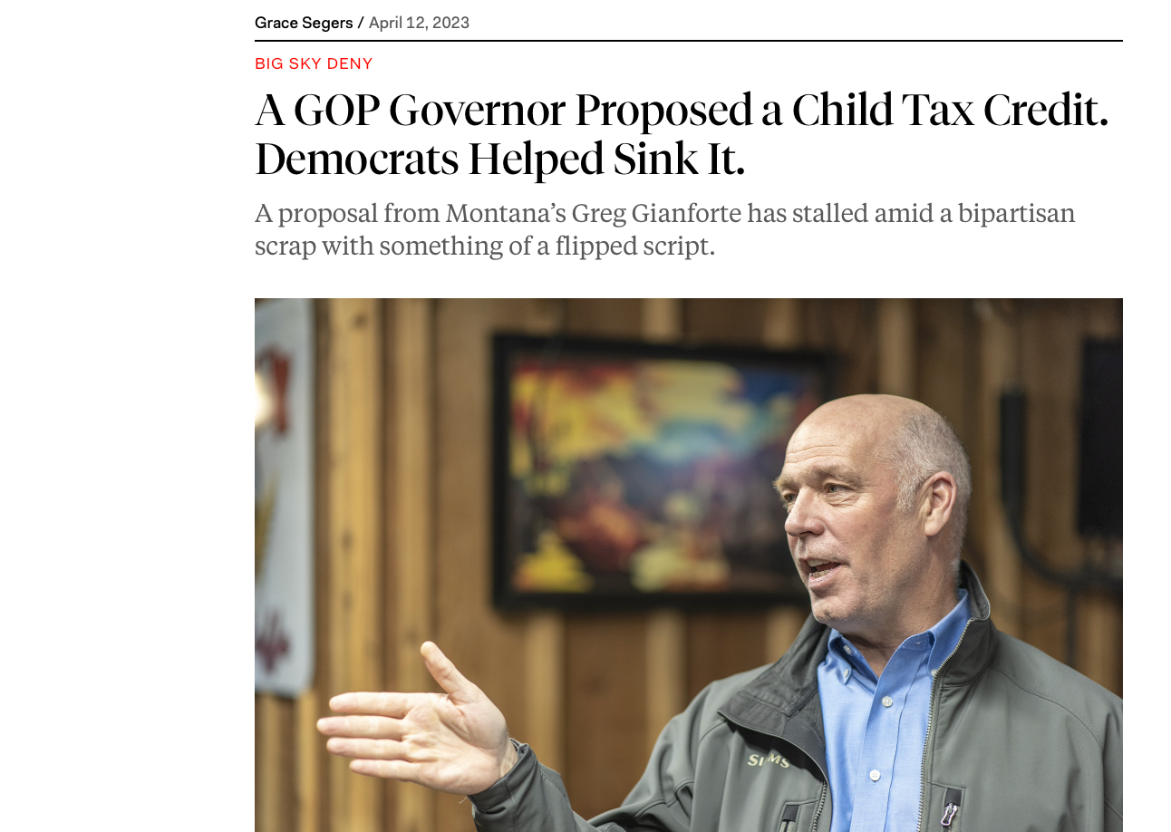
2022
Company

Slide 9
THANK YOU
For coming to my TED Talk.

Slide 11
Providing Technical Assistance on state policy levers for social programs
Policies include social programs like SNAP, TANF, WIC, CCDF, and others.
Tax credits can include CTC, EITC, CDCC, and others.
We specialize in policy interactions (how changes to benefits under one program can affect families’ benefits under another).
We are working on state-level policy profiles for TANF and SNAP. Let us know if you’d like to join us in outreach around those in your state.
Please reach out: kchatfield@bankstreet.edu
Thank you!

Slide 12
Medicaid Unwinding: A Tale of Administrative Burden
Elisabeth Wright Burak
October 26, 2023
Notes:
Congress passed Families First Coronavirus Response Act (FFCRA) in March 2020, requiring states to keep most enrollees on Medicaid during the public health emergency (PHE) as a condition of a 6.2 %-point increase in federal funding (FMAP)
The disenrollment freeze resulted in continuous Medicaid enrollment, as long as three years for some enrollees.

Slide 13
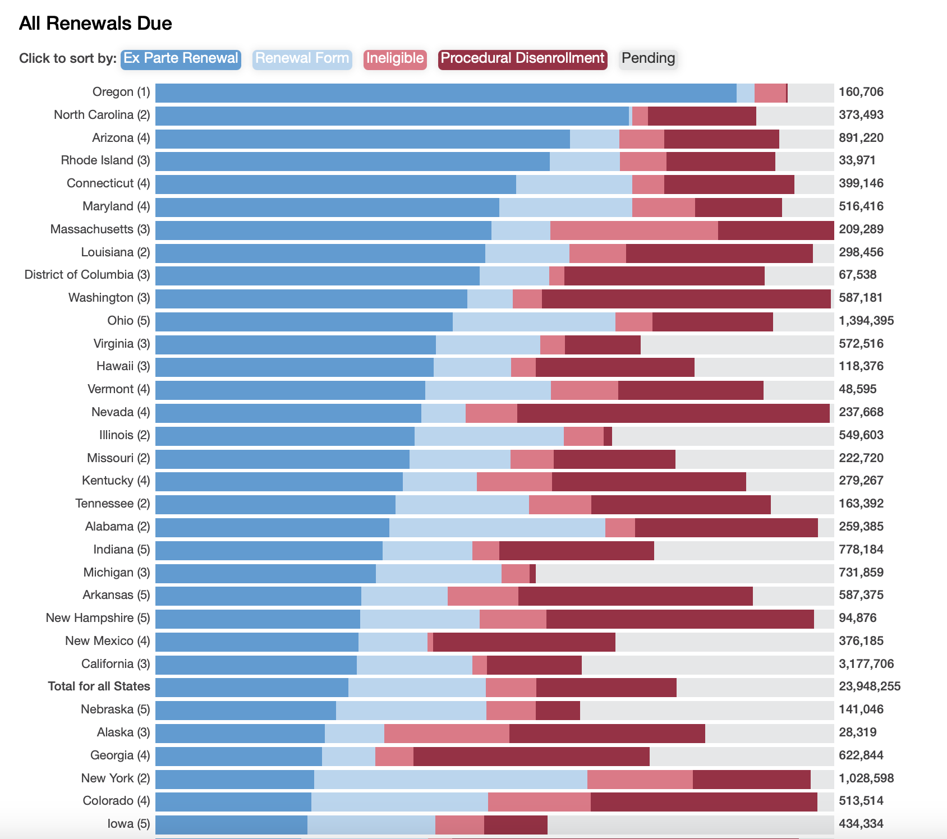
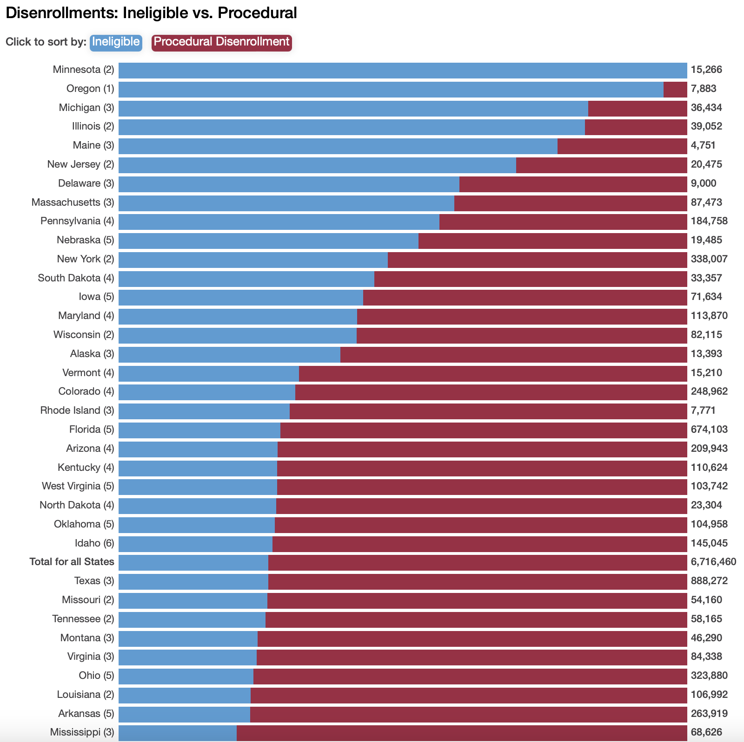
The Bad News: Renewal Outcomes so far…
Unwinding Renewal Outcome Tracker: https://ccf.georgetown.edu/2023/07/14/whats-happening-with-medicaid-renewals/

Slide 14
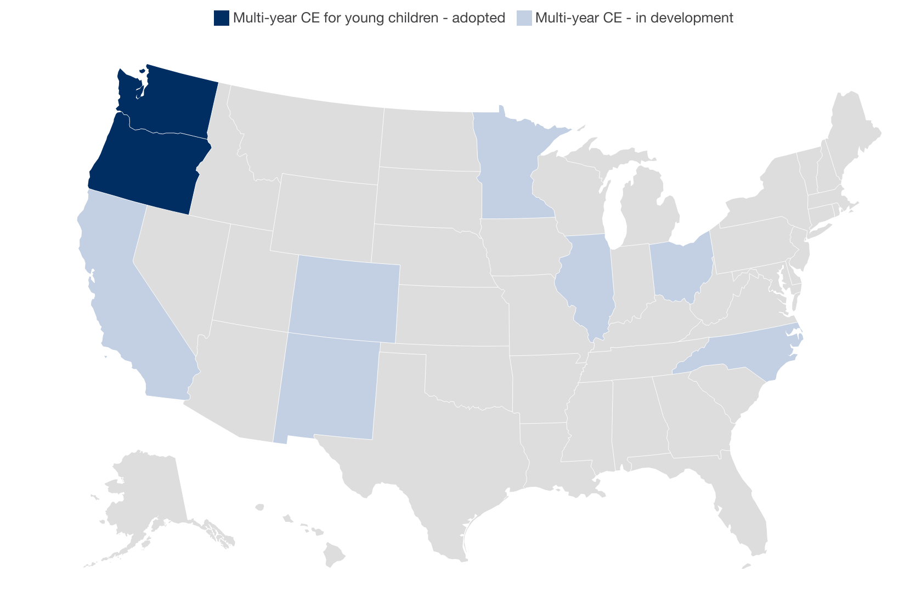
The Silver Lining? 9 states = continuous coverage for young children
California (0-5)
Colorado* (0-3)
Illinois (2 years, all ages)
Ohio (0-3)
Oregon (0-6)
New Mexico (0-6)
Minnesota* (0-6)
North Carolina (0-6)
Washington (0-6)

Slide 15
Round Table Discussions – Two Rounds

Slide 16
What state levers can you pull to support family economic security?
THINK
What is at least one FES policy that you think might have legs in your state next session?
PAIR
Turn to a partner and share your ideas. Ask questions of each other.
SHARE Popcorn shares. What are some ideas of policies that you might go for?

